Slide 1
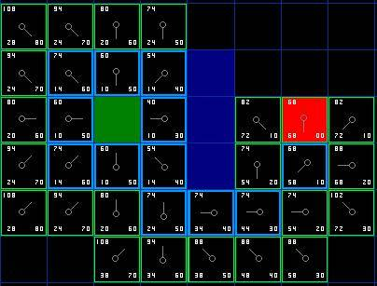
A* - Part II
Programming – AI for Games
Last modified 08/02/16 by Sam Cartwright

Slide 2
Contents
More Advanced A* Graphs
Choosing edge weights
One way paths
A Variety of Heuristics
Grid Based Graphs
8 Way Graphs
Arbitrary Position Nodes
Admissible and Nonadmissible Heuristics
Breaking Ties

Slide 3
More Advanced A* Graphs
So far we’ve described simple pathfinding graphs, where each edge weight is the distance between the two nodes.
We can add a lot more variety to our graphs by adding a few more options.

Slide 4
Choosing Edge Weights
So far we’ve only covered using the distances between nodes as the cost of the edges.
There are many other weightings we could apply to our graphs.
Weightings based on terrain types
Swamps would be much slower than dry land.
Weightings based on danger levels
You might want your agents to avoid the enemy base or other dangerous areas.
Different types of agents
You might not store the weightings directly in the edges themselves.
Instead just store what kind of terrain it is
Different agents in the game could have their own table of weightings based on terrain types
A tank would have very different weightings to a bicycle

Slide 5
Choosing a Heuristic
The Heuristic for an A* search has a huge impact on how fast the algorithm runs, as well as what your final path is.
As such we want to be able to understand all the options of heuristic available to us.

Slide 6
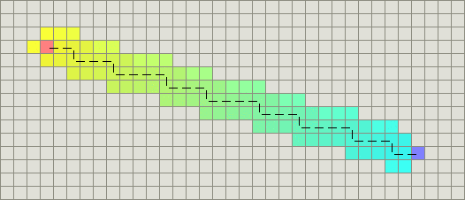
Heuristics for Different Graph Types
4-way Grids
Manhattan Distance (x diff + y diff )
If there are no obstacles, this is a perfect heuristic for 4 way grids

Slide 7
Heuristics for Different Graph Types
8-way grids
For 8 way grids, we think about the fact that we can only move in straight lines or at 45 degree angles.
We have more freedom than 4 way grids, but using the straight line heuristic still isn’t quite accurate.
Diagonal movement is efficient, so we want to move as far as we can diagonally and then add the rest of the trip length to the end.

Slide 8
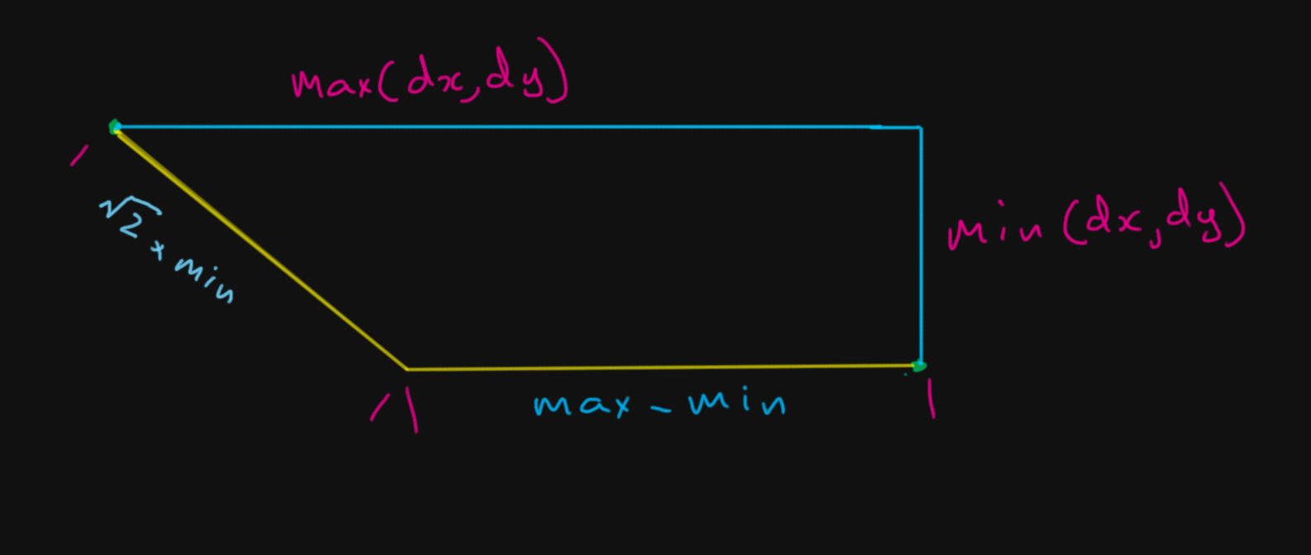
Heuristics for Different Graph Types
8-way grids

Slide 9
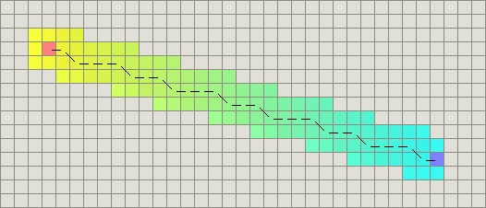
Heuristics for Different Graph Types
8-way grids
Sqrt(2) * min( dx, dy ) + ( max( dx, dy ) – min ( dx, dy ) )

Slide 10
Heuristics for Different Graph Types
Arbitrary Nodes
Straight Line distance

Slide 11
Admissible Heuristics
An admissible heuristic is one that always underestimates how close the node is to the goal.
All the heuristics we’ve looked at so far have been admissible.
An admissible heuristic will guarantee A* gives the shortest path.

Slide 12
Inadmissible Heuristics
Inadmissible Heuristics are ones that sometimes overestimate how close you are to the goal
Inadmissible heuristics no longer guarantee shortest path, however they can mean that A* might pick fewer nodes, leading to faster execution.
The simplest form of inadmissible heuristic is to just multiply your H value by a constant.
This works really well in empty spaces, but can cause problems when navigating more complex areas.

Slide 13
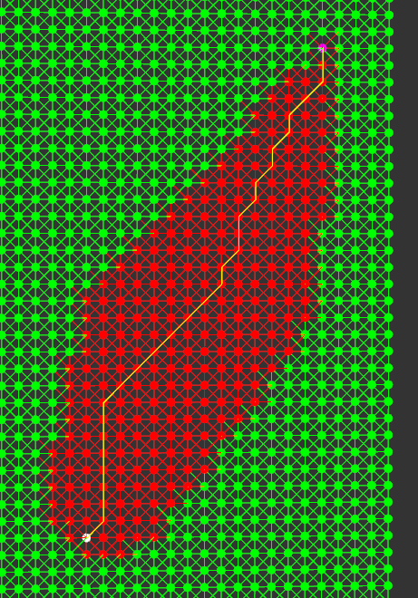
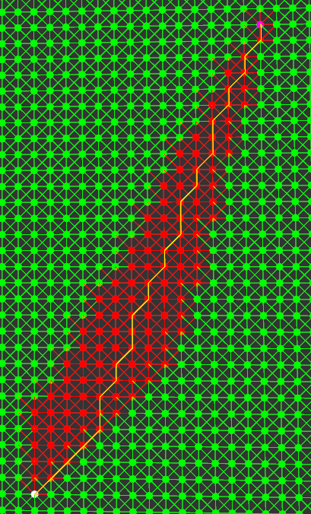
Inadmissible Heuristics
F = G + H
F = G + ( H * 1.075)

Slide 14
Choosing a Heuristic
There is no one size fits all best heuristic
You need to choose the best one for your graph and the entities that will be traversing it.

Slide 15
Summary
Variety can be added to your graphs by adding
Weights based on terrain types/danger levels
Different types of agents
8-way grids
Admissible heuristics guarantee A* will return the shortest path
Inadmissible heuristics may speed up the algorithm, but the shortest path can no longer be guaranteed

Slide 16
References
Ian Millington, 2009. Artificial Intelligence for Games. 2 Edition. CRC Press.

